Slide 1

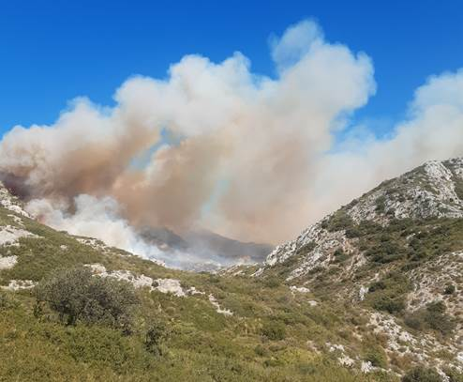
OPIES FIRE
EXERCICE 3- FIRE COMPLEXITY ANALYSIS

Slide 2
Context
We are at the end of august in the south of France
Resources avalaible : 180 firefighters, 40 forest fire engines, 1 tactical fire team, 1 helicopter commando forest fire, 2 water bomber helicopters, 5 command staffs, 5 air tankers (CANADAIR)
At 4PM a forest fire is seen near the town of VELAUX

Slide 3
The area : land levelling
Relief with a big valley from west to east
Positive slope
Left side : a positive slope
Right side : a positive slope

Slide 4
The area : planimétrie
Back and front : access roads but they are not very larges and the traffic could be a problem
Around the outrop : fire paths

Slide 5
The area : vegetation
Law vegetation : brush
Left side : thick brush
Right side : brush

Slide 6
The area : others items
Airport at less than 10km

Slide 7
The area : water resources
  Water hydrants near AUREILLE town
  In burned area, no water point

Slide 8
The area : houses and population
Front : houses
Touristic area with people on the paths

Slide 9
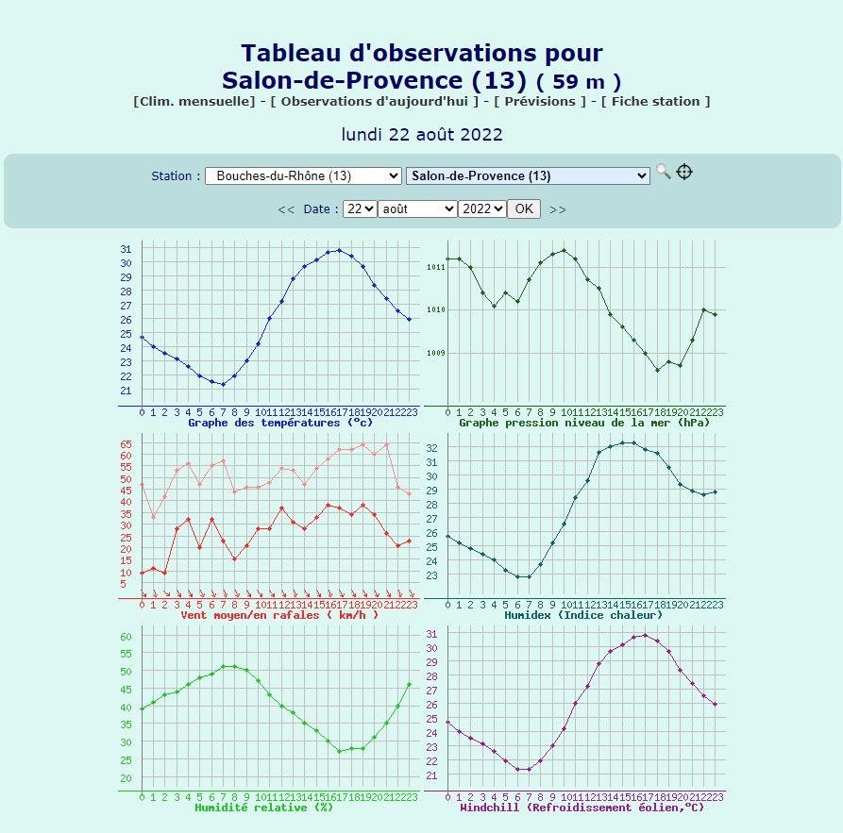
Weather conditions

Slide 10
Predicted fire behavior ?
Let’s describe the fire behavior…

Slide 11
Anticipation 1 : first hour
Left side : fire stops at the ridgeline
Right side : fire stops in the middle of the slope
Front side : is going to the east

Slide 12
Anticipation 2 : after 1 hour
Left side : fire stops at the ridgeline
Right side : fire increase to the ridgeline
Front side : fire expansion will slow in a negative slope

Slide 13
Operational response ?
Let’s discribe the objectives and the manoeuvre

Slide 14
Objectives
Protect population and houses
Limit the expension of the sides
Stop the fire front

Slide 15
Manœuvre
Right side : stop the fire at the ridgeline with airplane water bombing and extinguish with long hose line
Left side : tackle hotpoints on the ridgeline with helicopter water bombing
Front side : create an access for heavy engines

Slide 16
Balance sheet
Size : 95 ha
Structures destroyed : 0
Structures damaged : 0
Civilian injuries : 0
Firefighters injuries : 0
Cause : criminal

Slide 17
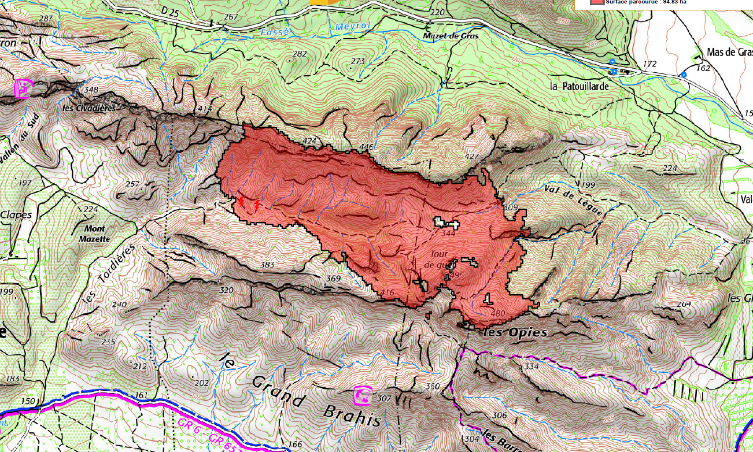
Burned area

